Slide 1



AI JUGAAD SQUAD
Page 01
Protecting the Digital World
AI for
Digital Security
-

Slide 2
AI JUGAAD SQUAD
Page 02
INTRODUCING AI JUGAAD SQUAD’s TEAM MEMBERS
About Us
⚡ TEAM LEADER
RAKSHIT RAJ
⚡ TEAM MEMBERS
ARYAN AMIT ARYA
SHRENIKA RAJPOOT
DILISHA
AI JUGAAD SQUAD
~ 2025 BATCH

Slide 3
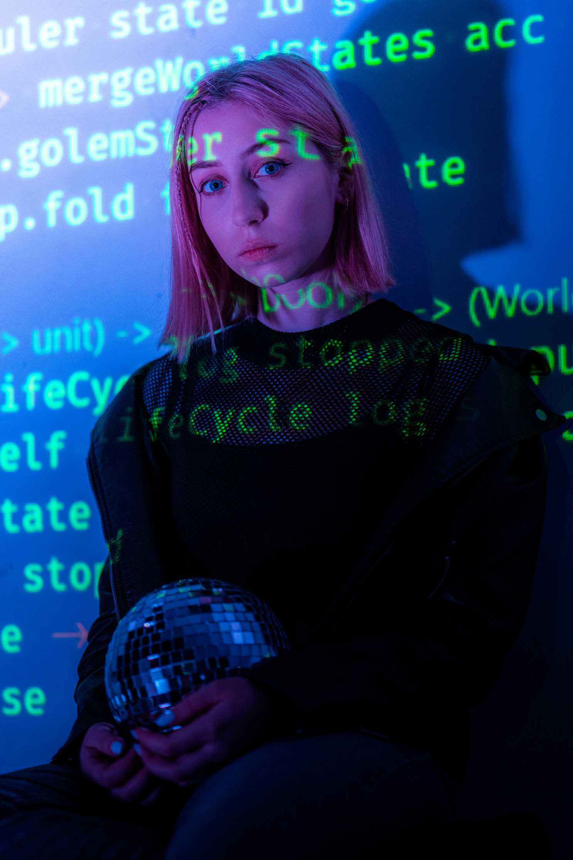
AI JUGAAD SQUAD
Page 03
Problem Statement
👉 Modern technological and cyber threats, such as advanced cyber-attacks, autonomous weapon systems, and manipulated information streams, have become so fast, numerous, and complex that traditional human abilities for detection, analysis, and response are insufficient.
👉 Human teams are now routinely outpaced by automated attacks, persistent threat actors, and rapidly evolving malicious tactics, leading to heightened security, economic, and safety risks.

Slide 4

AI JUGAAD SQUAD
Page 04
Relevance
📊 Escalating Risks: Critical infrastructure, personal data, and national security now face continuous and automated threats, making manual monitoring and intervention obsolete and increasing systemic vulnerabilities.
🤖 AI and Automation: The use of AI in both attacks and defense has created an arms race, with attackers automating their methods to penetrate defenses faster than human teams can respond.
📰 Societal Impact: These threats can disrupt economies, influence political stability, and even pose existential risks through technologies that exceed regulatory and ethical controls.
📝 Need for New Solutions: This environment necessitates advancing automated, intelligent, and adaptive security systems that can keep pace with evolving threats and minimize the overwhelming burden on human analysts.

Slide 5

AI JUGAAD SQUAD
Page 05
🤖 AI & Machine Learning
👉 We built a lightweight demo application using Streamlit that automatically analyzes log data and network events.
👉 The system ingests raw logs, extracts key behavioral features such as request volume, payload entropy, suspicious keywords, and URL patterns.
👉 Using an IsolationForest machine learning model, it identifies unusual or potentially malicious activities in real time.
👉 The tool then provides quick remediation suggestions, highlighting why an IP or user was flagged e.g., high suspicious URL ratio, abnormal payloads, or large request spikes.
📝SOLUTION PROPOSED

Slide 6






AI JUGAAD SQUAD
Page 06
Technology Stack
Tools
Python 3.10+ : Main Language
Streamlit : Quick UI for demo and Deployment
Pandas / NumPy : Data Processing
Scikit-Learn : IsolationForest anomaly Detection
Matplotlib : Simple Charts
tldextract : URL Parsing and Heuristics

Slide 7
AI JUGAAD SQUAD
Page 07
CONCLUSION
⚡ AI-driven detection is essential: Modern cyber threats are too fast and complex for human-only analysis.
🤖 Our MVP demo shows how lightweight AI + automation can detect anomalies, suspicious URLs, and manipulated information in real time.
📊 Streamlit-based prototype provides quick visualization, exportable alerts, and a judge-friendly demo flow.
🚀 Future scope:
Integration with live threat intelligence feeds
Automated incident response (blocking & notifications)
Scalable deployment for real-world use
👉 Key Takeaway: AI-powered digital security enhances speed, accuracy, and adaptability — making it a vital solution for the next generation of cyber defense.

Slide 8
AI JUGAAD SQUAD
Page 08
THANK YOU
REGARDS AI JUGAAD SQUAD

